Slide 1



Improving Evaluation & Treatment of UTI in the Elderly:
A Cross-Continuum Approach to Antibiotic Stewardship
Southbridge Rehabilitation and HealthCare Center And Harrington Memorial Hospital

Slide 2
Goals
Educate Licensed Nurses, MD’s and family members on ASB, UTI’s and Antibiotics
Reduce unnecessary antibiotic use
Joint collaboration between our facilities to facilitate change
Create a culture change
  Mental Status change does not always mean UTI
  Not treating does not mean Do Nothing
“Don’t just do something – stand there!”

Slide 3
How it is Going at Southbridge Rehabilitation and HealthCare Center

Slide 4
What we did
Medical Director attended the UTI conference and participated in the education process
Educated and facilitated culture change within the facility with help from the Medical Director, Nursing Management Team, Staff Development/ Infection Control and frontline Licensed Nurses
Had an educated discussion with psychiatrist about reducing orders for routine UA+CS during psychiatric evaluations
Created an easy to use form for Licensed Nurses using the McGeer's Criteria and Interact UTI Care Pathway
Worked with Harrington Hospital to collectively reach our goals

Slide 5
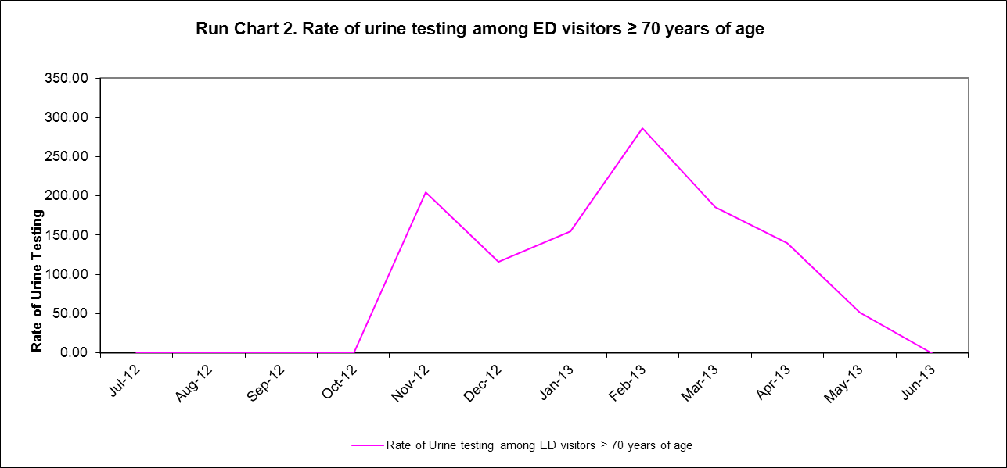
How is it going at Harrington Hospital

Slide 6
What Seemed to Matter
SRHCC’s Medical Director was committed to this project and being involved in the culture change. He is also a physician at Harrington Hospital and a PCP in the community. His unique relationship with both the facilities helped to facilitate collaboration and bring positive results. Since January 2013 we have not sent a resident to the ER with UTI symptoms and no resident has transferred from our facility to the ER at Harrington and quickly returned with the diagnosis of a UTI
Education and empowering the Licensed Nurses to monitor before we treat has also had a large impact on the results of the project

